Slide 1
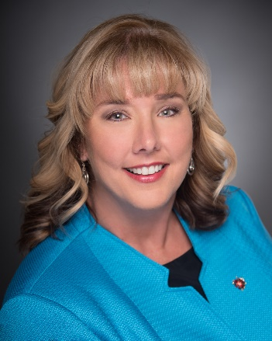
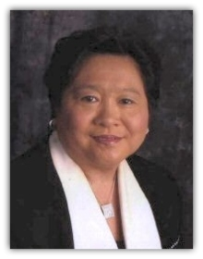
Invited Guests
Joni Brady
DNP RN-BC CAPA
Chair ICPAN
Maureen Cooney
DNP FNP RN-BC
President ASPMN
Holly Ervine
MSN RN NPD-BC CNOR
President AORN
Dina Krenzischek
PhD RN CPAN FAAN FASPAN
Chair CSPS

